Slide 1

Title slide + image
MagPar: A Particle Filtering approach to Magnetic Field Localization
SC42170 | Tjalle Aalbers and Tom Lijding

Slide 2

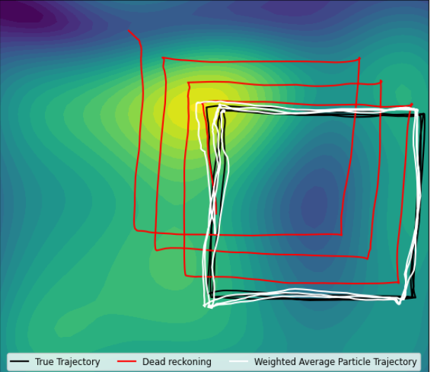



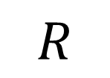
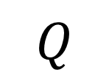


Structure
Problem Setup
Particle Filter Implementation
Tuning the Filter
Final Comments
Model
Updates
$$Q$$
Keeping the support
$$p_{t+1}=p_{t}+Δp_{t+1}+w_{t+1}$$
$$\tilde{w_{t}^{i}}=p\left(y_{t} ∣ x_{t}^{i}\right)w_{t−1}^{i}$$
Challenges
$$R$$
Nonlinearity
Results
Support
Use physics knowledge where possible
$$Q_{init}$$
Point estimate
Approach
$$N$$
$$p_{init}≈{\left[0 0\right]}^{T}$$
Particle Filter
Tuning

Slide 3
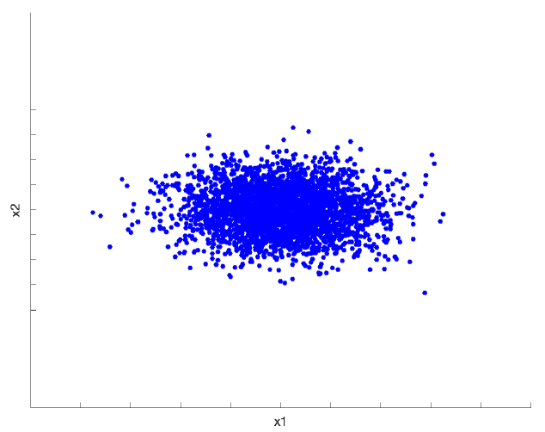
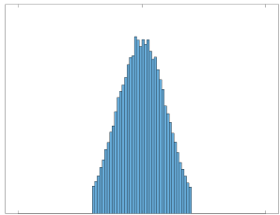











Problem Setup
Model
Challenges
Approach
Dynamic update
General
$$p_{t+1}=p_{t}+Δp_{t+1}+w_{t+1}$$
Nonlinearity of measurements
Cannot apply the (classic) Kalman Filter!
Particle Filter
$$p_{t}∈R^{3}$$
: Position
$$Δp_{t}∈R^{3}$$
: Change in position
Particle Filter
$$w_{t}∼𝒩\left(0_{3×1},Q\right)$$
: Additive Gaussian noise
Keeping support of distribution
Tune covariances such that we keep support!
Measurements
$$Q^{k}→Q^{k+1}$$
$$y_{t}=f\left(p_{t}\right)+v_{t}$$
$$R^{k}→R^{k+1}$$
$$f\left(⋅\right)$$
: Nonlinear function (GP)
$$Q_{init}^{k}→Q_{init}^{k+1}$$
How (best) to take a point estimate?
$$v_{t}∼𝒩\left(0_{3×1},R\right)$$
: Additive Gaussian noise

Slide 4



Particle Filter Recap
Algorithm
Important Reminders
Filtering cycle
Initial samples
Propagate
Only use when difficult to sample from original distribution! (otherwise just use a Kalman filter)
1
Resampling
Update weight
Remember to keep the support of original distribution!
Bootstrapping
2
$$x_{t}^{i}∼q\left(x_{t} ∣ x_{1:t−1},y_{1:t}\right)$$
$$x^{i}∼p\left(x_{t} ∣ x_{t−1}\right)$$
$$\tilde{w_{t}^{i}}=\frac{p\left(y_{t} ∣ x_{t}\right)p\left(x_{t} ∣ x_{t−1}\right)}{q\left(x_{t} ∣ x_{1:t−1},y_{1:t}\right)}w_{t−1}^{i}$$
$$\tilde{w_{t}^{i}}=p\left(y_{t} ∣ x_{t}\right)w_{t−1}^{i}$$

Slide 5
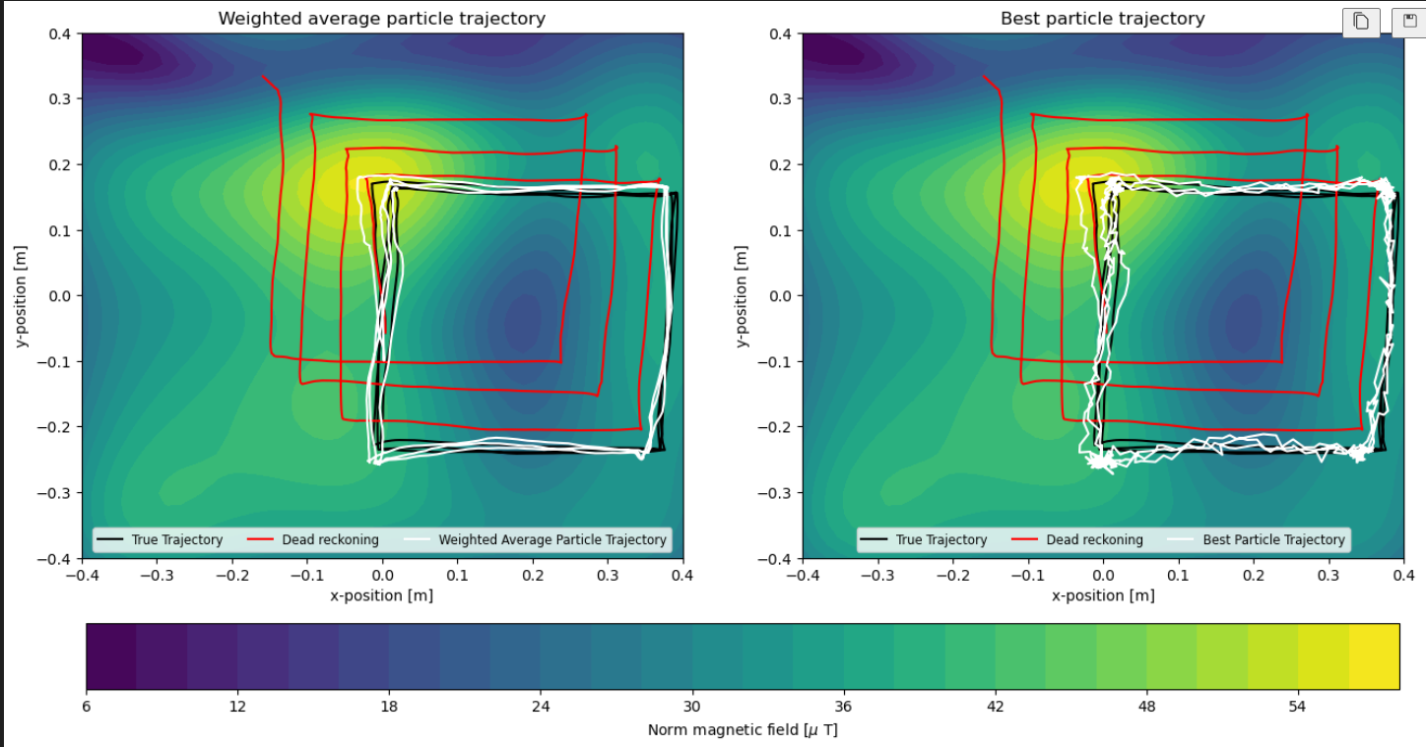

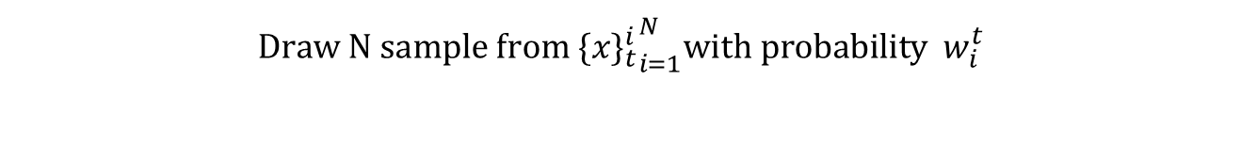
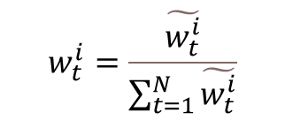
Particle Filter Implementation
Updates
Results
Propagation/Dynamic update
$$p_{t+1}=p_{t}+Δp_{t+1}+w_{t+1}=p\left(x_{t} ∣ x_{t−1}\right)$$
Measurement update
$$\tilde{w_{t}^{i}}=p\left(y_{t} ∣ x_{t}^{i}\right)w_{t−1}^{i}$$
Reweighting :
$$w_{t}^{i}=\frac{\tilde{w_{t}^{i}}}{\sum_{t=1}^{N}{\tilde{w_{t}^{i}}}}$$
Normalization :
Resampling
$$\text{Draw} \text{N} \text{sample} \text{from}{{ \{x\}}_{t}^{i}}_{i=1}^{N}\text{with} \text{probability}{ w}_{i}^{t}$$
Good tracking! Smooth (average case) and no drift, succesfully able to localize
Eratic path for the “best” particle trajectoy. Due to switching between different particles

Slide 6




Tuning the Filter
Variable
Effects
Increasing
Decreasing
More random particle trajectories (useful if model innacurate)
Erratic trajectory
Divergence
$Q$: Process covariance
$R$: Measurement covariance
Erratic trajectory, all measurements high probability
Degenerate particles
$Q_{init}$: Initial position covariance
Degenerate particles
Inaccurate tracking
Divergence
$N$: Amount of particles
Better tracking (approach true distribution)
Decreased computational complexity
Conclusion
Choose Q, relatively small (accurate model), R relatively big (noisy measurements), and initial Q small (we start close to true position)

Slide 7
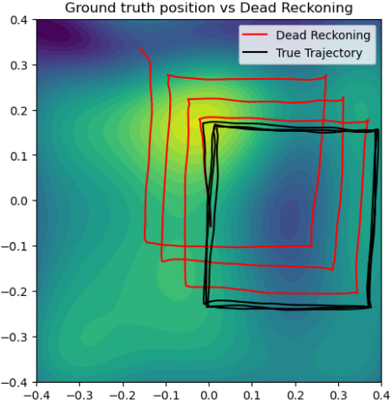

Final Comments
Keeping the support
Use physics and knowledge where possible
$$\text{supp}\text{\{}p\left(x\right)\}⊆\text{supp}\text{\{}q\left(x\right)\}$$
$$p_{init}≈{\left[0 0 0\right]}^{T}$$

